Slide 1
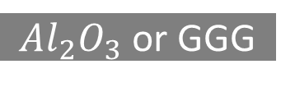
Cr/Au
Ru
Ta
Cr/Au
CoFeB
Ru
MgO
Ta
CoFeB
CoFeB
CoFeB
$Al_{2}O_{3}$ or GGG
MgO
MgO
FeGa
FeGa
FeGa
FeGa
PMN-PT
PMN-PT
PMN-PT
PMN-PT
PMN-PT
Kapton
Kapton
Kapton
Kapton
Kapton
Thin-film 1
Thin-film 2
Thin-film 3
Thin-film 4
Thin-film 5

Slide 2










$$y$$
Piezoelectric
$$W_{3}$$
$$W_{1}$$
$$x1$$
$$W_{4}$$
$$x_{2}$$
$$x_{3}$$
$$W_{5}$$
$$W_{2}$$
Read
$$W_{6}$$
Insulator
Magnetostrictive
Write

Slide 3






















$$y$$
Piezoelectric
$$W_{3}$$
$$W_{1}$$
$$Y_{1}$$
$$x1$$
$$W_{4}$$
$$x_{2}$$
$$X_{1}$$
$$W_{5}$$
$$x_{3}$$
$$Y_{2}$$
$$W_{2}$$
Read
$$W_{6}$$
Insulator
Magnetostrictive
Write
$$W_{3}$$
$$Y_{1}$$
$$W_{1}$$
$$W_{4}$$
$$Y_{2}$$
$$W_{5}$$
$$X_{1}$$
$$W_{2}$$
$$W_{6}$$

Slide 4


















$$W_{3}$$
$$Y_{1}$$
$$W_{3}$$
$$W_{1}$$
$$Y_{1}$$
$$W_{1}$$
$$W_{4}$$
$$W_{4}$$
$$Y_{2}$$
$$X_{1}$$
$$W_{5}$$
$$W_{5}$$
$$X_{1}$$
$$Y_{2}$$
$$W_{2}$$
$$W_{2}$$
$$W_{6}$$
$$W_{6}$$

Slide 5




$$y$$
Piezoelectric
$$x1$$
Read
$$x_{2}$$
Insulator
Magnetostrictive
Write
$$x_{3}$$

Slide 6
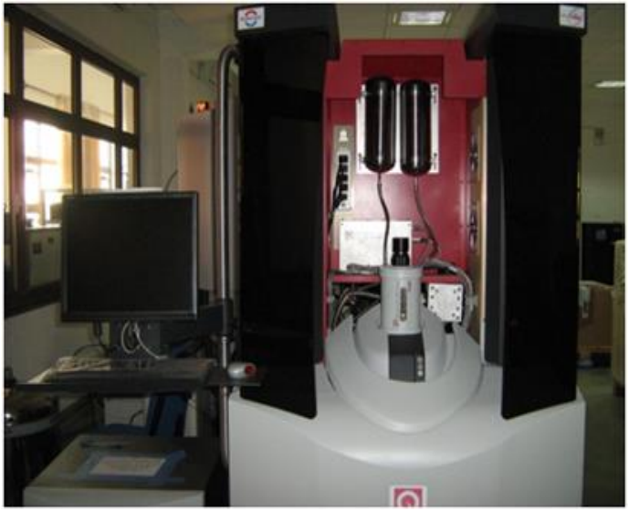
VSM (Vibrating Sample Magnetometer)
H field
Pick up coil
Sample position
transformer
SQUID with electronics
M Mohanlal Naik
IISER Bhopal
6

Slide 7
Laser source
Photo detector
Flexible cantilever
Magnetic tip
Sample

